Slide 1
Emotional Intelligence:

Slide 2
"All learning has an emotional base"
-Plato
Education shapes the destiny of any nation.
Education is one of the important phases of learning for human beings.

Slide 3
Intelligence is a popular word used in day to day life.
Definition of Intelligence.
“Intelligence is the aggregate or global capacity of the individual to act purposefully, to think rationally and to deal effectively with his environment (David Wechsler)
Emotional Intelligence (EI) refers to the ability to perceive, control and evaluate emotions.
Notes:
David Wechsler (January 12, 1896 – May 2, 1981) was a Romanian-American psychologist.He developed well-known intelligence scales, such as the Wechsler Adult Intelligence Scale (WAIS) and the Wechsler Intelligence Scale for Children (WISC)

Slide 4
Emotional Intelligence:
“the ability to perceive, understand and influence our own and others’ emotions, across a range of contexts, to guide our current thinking and actions, to help us to achieve our goals”.

Slide 5
While the concept of EI (the knowledge and ability, to influence emotions of others, as well as yourself) may sound relatively straightforward, there's actually quite a lot of debate among researchers and scholars as to what the precise nature of Emotional Intelligence is.

Slide 6
There have been many models proposed as a means of better defining EI:
  the Ability Model,
  the Trait Model,
  the Mixed Model.

Slide 7
Ability Model
- Peter Salavoy and John Mayer

Slide 8
The Ability Model of Emotional Intelligence is to be considered a new intelligence and confined thereby to the standard criteria for all new intelligence.
The original research supporting this model initially defined EI as
"the ability to perceive emotion, integrate emotion to facilitate thoughts, understand emotions, and regulate emotions to promote personal growth."

Slide 9
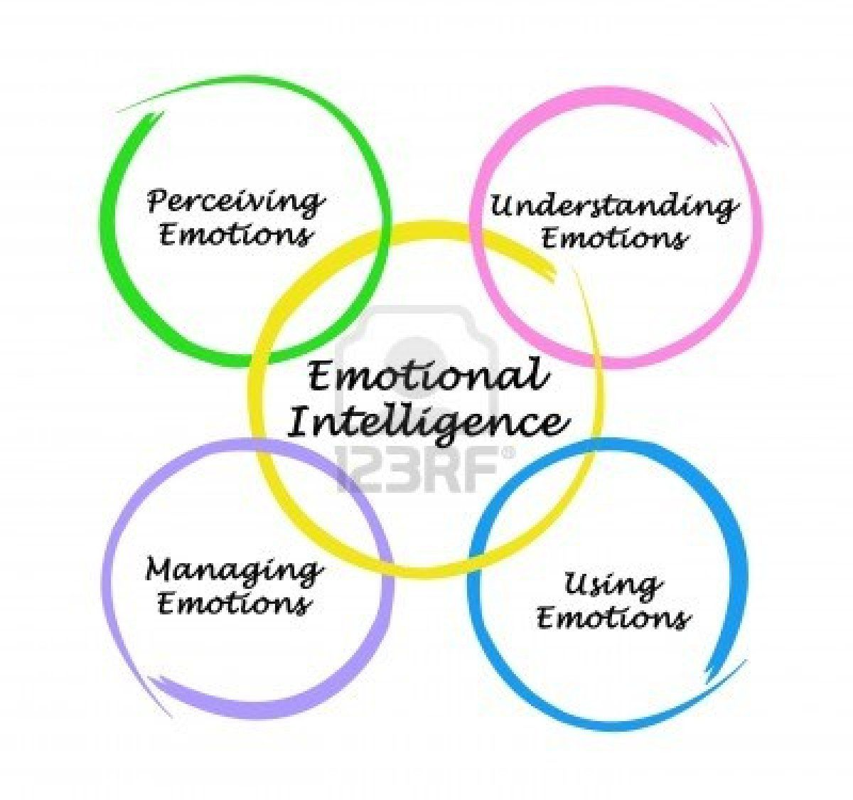
Ability Model recognizes that EI includes four distinct types of ability:

Slide 10

Emotional perception.

Slide 11
Emotional perception.
Ability to:
  Identify emotion in a person’s physical and psychological states
  Identify emotions in other people
  Express emotions accurately and express needs related to them
  Discriminate between authentic and inauthentic emotions

Slide 12
Emotion perception is generally thought to be a very basic aspect of Emotional Intelligence, because it is necessary to complete any of the other processes involved in the Ability Model.
This also includes the individual's ability to recognize and identify their own emotions as well.
How will you identify/ perceive emotions?
Through facial expression, body language, pictures, voices, and so on, a person can recognize the emotions of others.

Slide 13
The difficulty that people on the autism spectrum
have with learning social cues is related to their inability, or limited ability, to recognize the emotions of others through their expressions; they often lack the ability to recognize the facial and body expressions of others that communicate their feelings.

Slide 14

Understanding emotions.

Slide 15
Understanding emotions
Ability to:
  Understand relationships among various emotions
  Perceive the causes and consequences of emotions
  Understand complex feelings, emotional blends, and contradictory states
  Understand transitions among emotions

Slide 16
This ability is built upon an understanding of the complexity of emotions.
While many people have the ability to recognize basic facial expressions, fewer of them are able to predictably recognize and understand emotion language and to appreciate the complex emotional relationships.

Slide 17
A lower ability to understand emotions may present itself in someone who struggles with understanding why a death or divorce may result in seemingly conflicted emotions all at the same time.

Slide 18

Use of emotion.

Slide 19
Use of emotion
Ability to:
  Redirect and prioritize thinking on the basis of associated feelings
  Regenerate emotions to facilitate judgment and memory
  Capitalize on mood changes to appreciate multiple points of view
  Use emotional states to facilitate problem solving and creativity.

Slide 20
The Ability Model relates to a person's ability to use emotions -- whether it is their own emotions or another person's emotions -- in order to achieve a desired outcome.
When thinking and problem-solving, emotions often must be considered, and a person skilled at using emotions can typically make decisions, primarily on the emotions or moods of themselves or others.

Slide 21
EXAMPLE:
In practical terms, think of a child who knows the best time to ask their parents for permission to do something; the child who asks for permission during a time when a parent is fearful, anxious, or angry, is less likely to be successful at using emotions.
However, any goodwill their parent has at the moment to their advantage, they are more likely to achieve their desired outcome.

Slide 22
Managing emotions

Slide 23
Managing emotions
Ability to:
  Be open to feelings, both pleasant and unpleasant
  Monitor and reflect on emotions
  Manage emotions in oneself and others

Slide 24
Managing emotions relates more specifically to someone's ability (or lack thereof) to regulate emotions in both themselves and others.
As the highest level of ability in the Ability Model, someone with high Emotional Intelligence would be expected to be able to manipulate the moods of themselves or others, essentially harnessing the mood and managing it to achieve their goals.

Slide 25
While emotional manipulation is generally thought of as negative, it can serve extremely important purposes and does not necessarily have to be used in a harmful way, as people typically conceive it to be.

Slide 26
For example, a supervisor at a job may recognize that an employee is struggling with something emotionally and it is affecting their work. The supervisor (if they have a high level of Emotional Intelligence, according to the Ability Model) may be able to help motivate the employee by meeting their emotional needs through pep talks, a heart-to-heart conversation, or even a spirit of competition -- whatever that individual employee will respond to. In this type of situation, the emotional manipulation is positive for both the individual being manipulated or affected, as well as solving the problem of having an ineffective worker.

Slide 27
